Slide 1

CS1010: Programming Methodology
UNIT 1
What is a Program?

Slide 2




Hardware
Monitor and speaker (output)
Houses processor, memory, buses, etc.
Software
Keyboard and mouse (input)

Slide 3
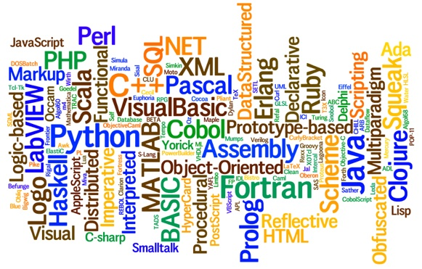
(Computer) Program
A sequence of step-by-step instructions given to computers to process data in order to perform a certain task.
Programming languages
Languages for writing programs

Slide 4
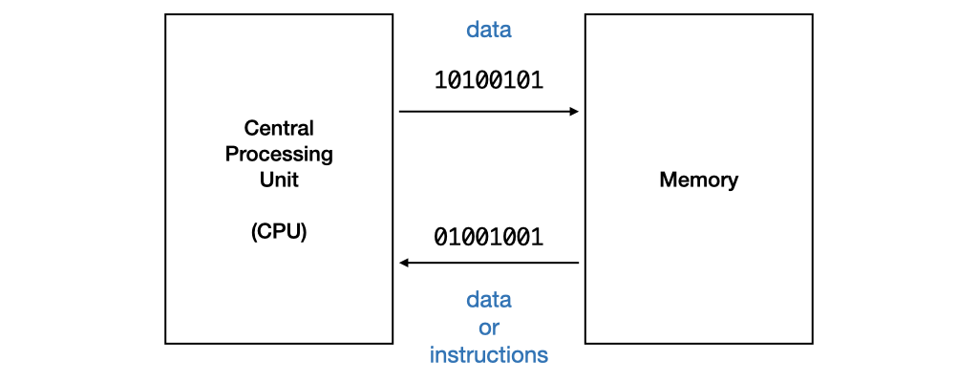
Types of Programming Languages
Machine code
Program to which computer can respond directly. Each instruction is a binary code that corresponds to a native instruction.
Eg: 0001001101101110

Slide 5
Types of Programming Languages
Assembly code
High-level language program
Use mnemonic to represent the instructions, such as incr, store, jump, etc. in a more human-readable way.
Still difficult to write since the operations are really simple.
Requires translation
Detailed knowledge of the machine is not required. High level of abstraction, such as control structures, functions, object-oriented programming.
Ease of writing and understanding.
Eg: Java, C, C++, Python.

Slide 6
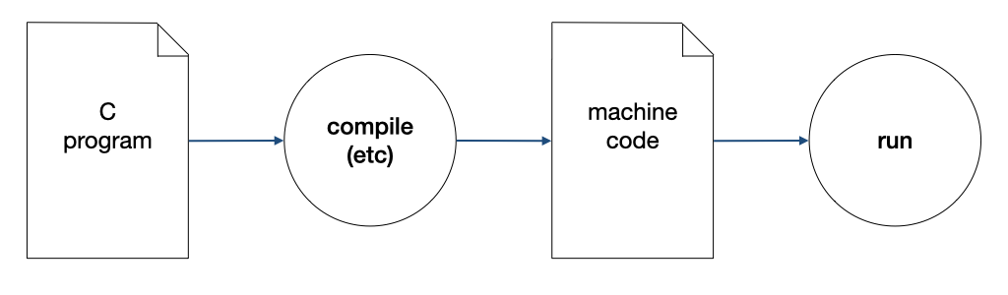
Compilation
A compiler compiles a program written in a high-level language to machine code.

Slide 7
The Edit, Compile and Execute Cycle
Compile
Execute
Edit
Use a compiler to translate the source code into executable
Use an editor to create/modify the source code
Execute/run the executable code
Process is iterative

Slide 8
What will You Learn?
The most important syntax element of C.
How a C program behaves.
Tools and techniques that will help you produce good and correct C programs.
Most importantly, how to write programs to solve computational problems!

